Slide 1
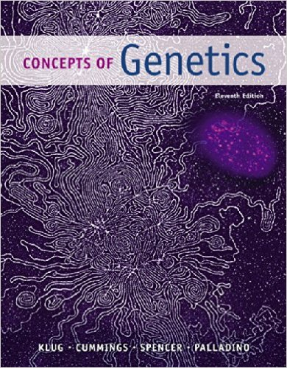
Molecular Biology Biol 480
Spring 2019
Heidi Super

Slide 2
Welcome!
Biol 480 is in large part a continuation of Genetics (Biol 215) which began with classical genetics and ended with a brief glimpse at molecular genetics.
My training is in Molecular Genetics and Cell Biology so the course is really fun to teach and relevant to my research

Slide 3
Syllabus
The syllabus is almost always underappreciated and underutilized.
Access it often---good information.
But…always ask questions if you are unsure or something seems unclear---I make mistakes—I forget—I am not that tech savvy….

Slide 4
Announcements/Assignments
See last slide—reading a paper.

Slide 5
Define Molecular Biology…
In a way the most focused of all fields of biology

Slide 6
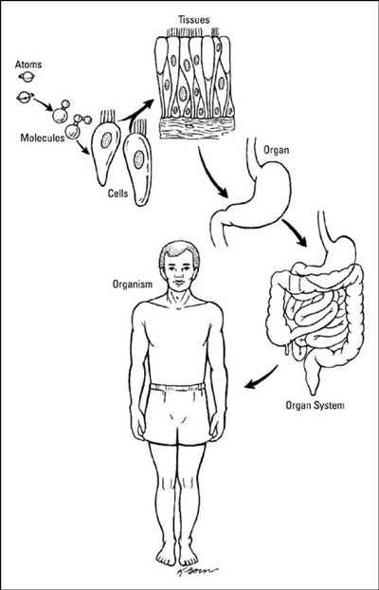
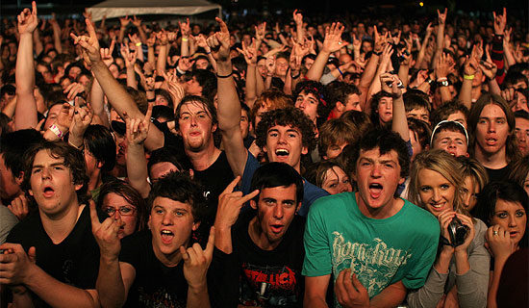
population

Slide 7
Chemically speaking…
A molecule is 2 or more atoms held by a covalent bond.
Biomolecules, those making up living things nearly always have shapes and properties that are in large part due to non-covalent bonds as well.

Slide 8
Small molecules
Molecules differ in size/composition
Cellular “small” molecules (molecular weight 100-1000)
Sugars
amino acids
nucleotides
water
fatty acids

Slide 9
These molecules facilitate communication, contribute to structure, and are the building blocks of the “large” molecules (macromolecules) of the cell.

Slide 10
Large molecules
Molecules >1000 molecular weight
Polysaccharides
Lipids
Nucleic Acids (DNA and RNA)
Proteins

Slide 11
Prototype cell
~70% water (small molecule)
Of the non-water part
~50% protein
~20% nucleic acids
~7% polysaccharides and lipids
~23% small molecules—other than water

Slide 12
Abundance reflects importance
Proteins---really define the cell
A skin cell differs from a muscle cell primarily in the subset of proteins it makes. (Both have the same small molecules, and of course both have the same DNA)

Slide 13
Differentiated/specialized cells

Slide 14
Roles of proteins
Structure---major component of the scaffolding/skeleton of the cell. Major component of chromosomes.
Catalysts---enzymes which facilitate chemical reactions
Communication---receptors and signal transduction molecules.

Slide 15
Roles of proteins (continued)
Regulation/adaptation---proteins regulate gene expression allowing cells to change activities.
Movement—of other molecules inside the cell or of the cell itself.
Immunity–Antibodies and many molecules involved in development and execution of immune responses are proteins.

Slide 16
Nucleic acids (DNA and RNA)
DNA---the molecular code for all RNA and protein of the cell. Regions of DNA (known as genes) can be transcribed into RNA. Think of it as the recipes carried by the cell for the working molecules.
These recipes are passed on to new generations (of cells—via mitosis) and accessed by the cell when needed ( by gene expression mechanisms).

Slide 17
RNA… a once underappreciated molecule!
Once thought to be an inactive intermediate in the synthesis of proteins, RNAs are now known to be the “rock stars” of the cell, with a central role in controlling gene expression.
e.g. A class of molecules called micro RNAs. Generally associated with reducing gene expression.

Slide 18
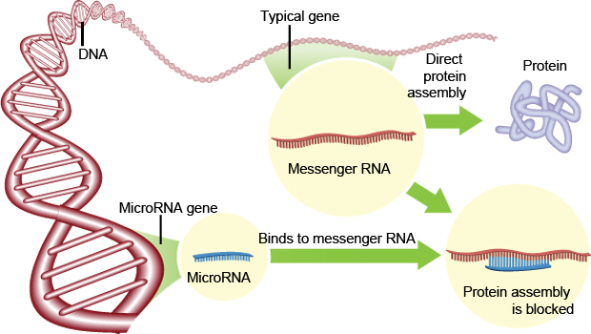

Slide 19
Other macromolecules
Polysaccharides.
Cell structure/strength (component of cell walls)
Stored energy
Modification of other molecules (proteins and lipids)

Slide 22
Lipids
Stored energy
Cell structure (membrane component)
cell signaling

Slide 23
polymers
All 4 classes of macromolecules (Protein, Nucleic acids, Lipids, polysaccharides) are considered polymers---large molecules built of small subunits (monomers)
Proteins from amino acids (20 kinds)
Nucleic acids from nucleotides (5 kinds)
Polysaccahrides from sugars
Lipids from fatty acids and glycerol

Slide 24
Homework
For Friday---read the article:
https://biodesign.asu.edu/news/dna-auto-pilot
And comments: https://www.news-medical.net/news/20190104/New-method-for-automation-of-DNA-origami.aspx
Be ready to discuss Friday.

